Slide 1
Data Mining 101
K-Means and k-d Trees

Slide 2
Problem Statement
Chris Cabral scraped all of the colors from the Behr website and wanted to:
Reduce the colors from 2000+ to a manageable palette
Given an arbitrary RGB color, find the closest color in the palette
This is a job for data mining!

Slide 3
K-Means
wikipedia
A type of cluster analysis
Not limited to 2-D
Basic Steps
Decide on the number of clusters (K)
Pick K centroids
For each point, determine its closest centroid
From the set of points associated with the centroid, calculate the new centroid
Repeat until there are no further changes
Credit: datasciencelab

Slide 4
K-Means - The Devil is in the Details
Decide on the number of clusters (K)
If you don’t know the number, there are algorithms to help you choose
Pick K centroids
Random is easy but kinda worthless
K++ is a method for choosing better starting points
For each point, determine its closest centroid
Euclid? Manhattan? Cosine?

Slide 5
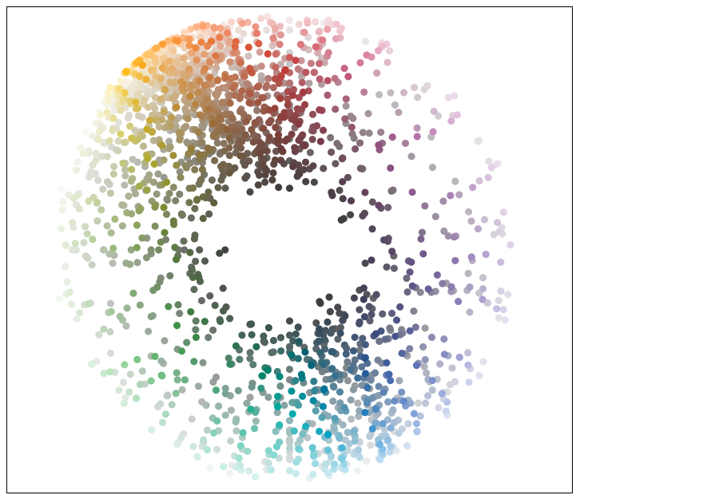
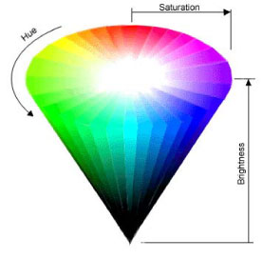
Behr Colors

Slide 6
Ready to Cluster
Get the swatches
Add parameters for HSV
Extract the vectors
#8e918c => (142.0,145.0,140.0)
Select the initial centroids
Use k++ to spread out the coverage
Find the clusters
Start with 8
Output the swatches

Slide 7
8 Color Palette

Slide 8
Improvements
The chosen colors are muddy and muted
No Reds
No Greens
Not “bright” => It is choosing the center!
RGB is not a good choice for the vectors
RGB is good for displays
Not completely orthogonal (Green = Yellow + Blue)
Try HSV instead

Slide 9
8 Color Palette via HSV

Slide 10
64 Color Palette via HSV

Slide 11
Part 2: Use only colors in the original palette
The resulting centroids have an arbitrary RGB (or HSL) vector
Now we need to find the “closest” color in 3D space
k-d trees are good for this

Slide 12
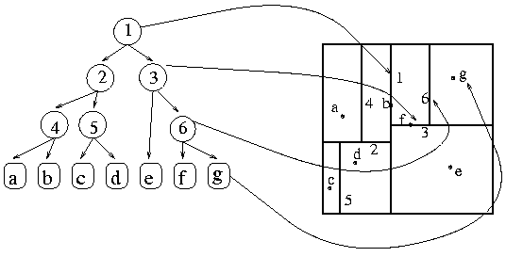
k-d Trees
wikipedia
A data structure that allows for O(n log n) searches for points in a k dimensional space
It is a binary tree where each level is a different axis
Used heavily in gaming to track the location of objects
Credit: MIT

Slide 13
How to find nearest color
Build a k-d tree using the same vectors that were used in the cluster analysis
For each centroid returned
Traverse the tree, using the branch that is “closer” to the specified color
Use the color that was closest during the traversal

Slide 14
8 Color Palette via HSV with nearest neighbor

Slide 15
64 color palette via HSL with nearest neighbor

Slide 16
One Final Note
The cluster algorithms are not deterministic
Heavily influenced by initial conditions
The “actual” solution is NP-Hard, so there are trade-offs to make this work

Slide 17
8 Color Palette via HSV with nearest neighbor (x6)

Slide 18
Further Reading
Source Code - https://github.com/JeffreyMFarley/clustersplaining
The webpage that started this all for me - https://rayli.net/blog/data/top-10-data-mining-algorithms-in-plain-english/

